Slide 1
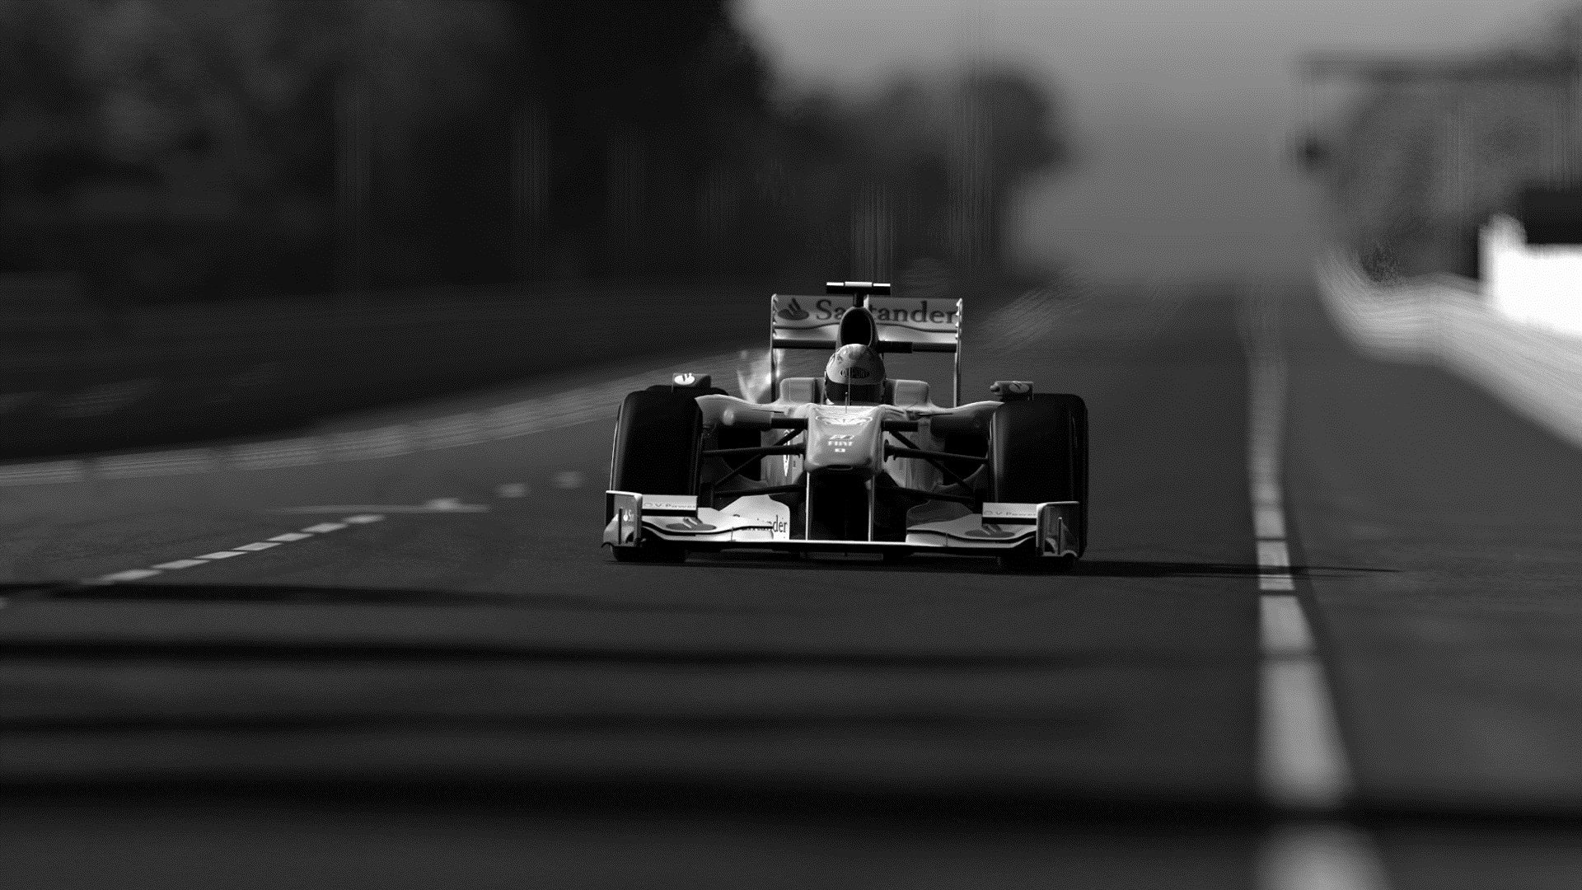
F1-Predict Software Project
I am excited to present this brief summary of my software project which will be submitted along with my project report

Slide 2
Presentation Outline
Project Introduction
Project Subject Area
Project Problem Statement
Project Goals and Objectives
Project Goals
Project Objectives
Project Literature Review
Project Methodology
Data Collection
Data Analysis
Participants
Project Management
Project Development
Tools Used
Machine Learning Models
Issues During Development
Project Testing
Testing Feedback
Issues During Testing
Project Deliverables
Learning Outcomes
Project Documentation
Project Presentation
Repository Explanation
Project Workflow
Project Walkthrough
Project Conclusion

Slide 3
Project Introduction
Project Subject Area
There has been a significate increase of interest towards deploying intelligent software in the field of Sport Analytics based on Machine Learning techniques. These algorithms come into play in order to gain a competitive advantage over competitors and challenge the unpredictable nature of sport given several external and internal factors that can shift the outcome of a single event.
One particular sport which has seen numerous breakthroughs in recent years in terms of innovative technology is Formula 1, the highest-class single-seater racing competition in the world followed by millions. Formula 1 is the pinnacle of motorsports and is a sporting spectacle to behold, but behind the scenes, there are hours upon hours of data collection and analysis to continuously evolve as well as improve both the vehicles and drivers.
Project Problem Statement
With the growing competitiveness in the world of motorsports, and hundreds of teams battling for the crown of the fastest on the grid, it becomes difficult for team managers to analyse their competitors, drivers, as well as their performance. The Formula 1 Results Prediction Application assists teams with this by predicting their chances at the championship, analysing how they are affected by external factors, predicting all team results, and suggesting the best drivers for their cars.

Slide 4
Project Goals and Objectives
Project Goals
The application should predict the future results of races for each team
The application should take into consideration the impact of a driver's performance metrics on race outcomes
The application should take into consideration the impact of a team’s performance metrics on race outcomes
The application should take into consideration the impact of external factors such as weather, race track, and travel on race outcomes
The application should suggest the optimum driver for a team’s car
The application should predict the chances of a team winning the Formula 1 championship
The application should display the predictions in an easy-to-understand format and allow users to view the different information it has to offer
Project Objectives
Create an application that can predict the results of future races taking into account all the factors that influence the outcome
To determine future results, the application will leverage machine learning to process, understand, and use the data about drivers, teams, and external factors
Integrate a database that the application can use to store and retrieve this data
Create a user interface which is user-friendly and attractive

Slide 5
Project Literature Review
This slide will briefly summarise the previous research and accredited pieces of work on the project subject area
M.Lewis. (2004, March 17). Moneyball: The Art of Winning an Unfair Game.is a prime example of data-driven performance optimization in sports based on the story of how a baseball manager used statistical data and analytics to build a competitive baseball team despite the small budget.
FIA. (2022). 2022 FORMULA ONE SPORTING REGULATION is the official rule book released by the governing body of motorsports, Fédération Internationale de l'Automobile known as FIA, to fairly manage the sport. This piece of work was essential to understanding the various rules and regulations that govern the sport as well as some insight into features of the sport that can influence the results.
C. Ditcher, M.OReilly, & E.Delahunt. (2021, March 20). Machine learning in sports science: challenges and opportunities is an academic paper investigating the use of machine learning and artificial intelligence integration in sports.
R.M.Musa, Z.Taha, A.P.P.A.Majeed, & M.R.Abdullah. (2018, September 19). Machine Learning in Sports: Identifying Potential Archers is a book researching the use of machine learning techniques to identify the potential of a person to become an archer.
O. Hubáček, G.Šourek, & F.Železný. (2019). Exploiting sports-betting market using machine learning is an academic research report aimed at employing machine learning models to predict sporting results and take advantage of sports-betting.
H. Sicoie. (2022, January 14). MACHINE LEARNING FRAMEWORK FOR FORMULA 1 RACE WINNER AND CHAMPIONSHIP STANDINGS PREDICTOR is an academic research report aimed at leveraging a machine learning application to predict race winners and championship standings for drivers and was the most influential piece of work on this project.
C. Garvin, D.Julian, B.Lee, & A.Kosikowski. (2022, May 20). F1 Race Prediction was another influential academic research paper focused on ranking and analysing several machine learning models when predicting races in Formula 1.
W. George. (2021, August 6). Formula 1 Championship Predictor is an article written to state various aspects and understandings of developing a formula 1 applications for predicting racing outcomes.
For more in-depth review of the above literature please have a look at the project report that is presentation is based on.

Slide 6
Project Methodology
Data Collection
The first step is to gather all the historical data using python scripts which collects all the necessary data from the Ergast API and store it in my database.
For more information about Ergast API navigate to: https://ergast.com/mrd/
Next step is to enrich the data with several features such as weather information and qualification information about each particular race. For each race collected from the API, a URL link from Wikipedia is appended as a column in the database, and by accessing the specific link using the Python library BeautifulSoup, I was able to extract information about qualification times as well as the weather during the race. An example of this Wikipedia page: https://en.wikipedia.org/wiki/2022_Bahrain_Grand_Prix
Finally, I perform data manipulation using python libraries, like Pandas and Numpy, to prepare the data and merge all the required table data into a single table which will be used throughout the application for predictions.
Data Analysis
Firstly, I analysed which tracks have hosted the most races.
Next, I decided to plot out the importance of qualification in pole position that leads to winning the races.
I then plotted the importance of racing in your home country present any trends of winning races in your home country.
In addition, I decided to create a scatter plot to understand trends between various features of the dataset.
The next slide will present these graphics.
Participants
During the initial phase and proposal of this project, I received some valuable guidance from my lecturer, Mr Richard Ndonye Ngung, who advised me on the setting up of the project thesis goals understandably and clearly.
During the second phase of this project, I was assisted by my lecturer Mr Anderson Chikazingwa who helped clarify the objectives of this report and project presentation.
Project Management
For this project, I decided to make use of the Scrum project management methodology to provide a structure for my project development life cycle.
I chose this methodology for many reasons including the promotion of incremental development, continuous improvement, ease of understanding and implementation, encouragement of planning, improved focus, adaptability to change, and production of results that can be measured throughout the project to effectively track the progress.

Slide 7
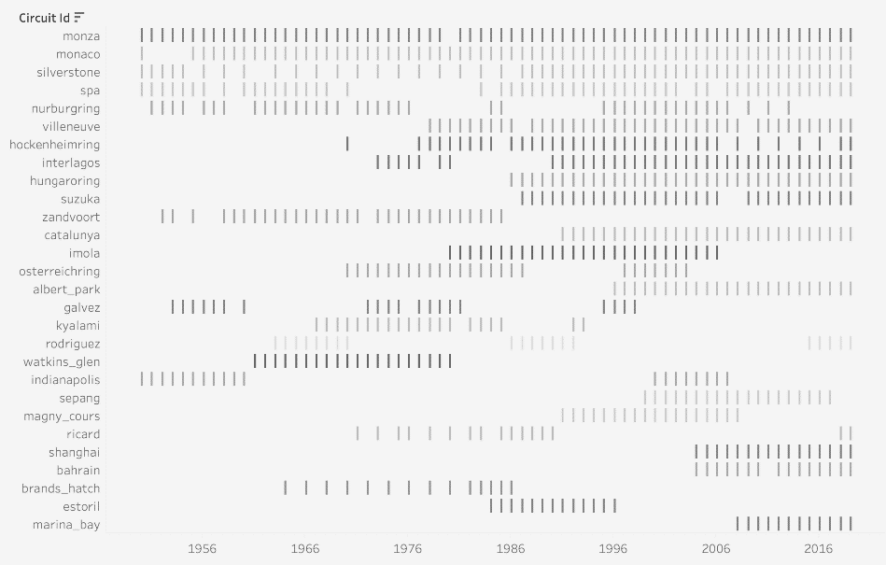
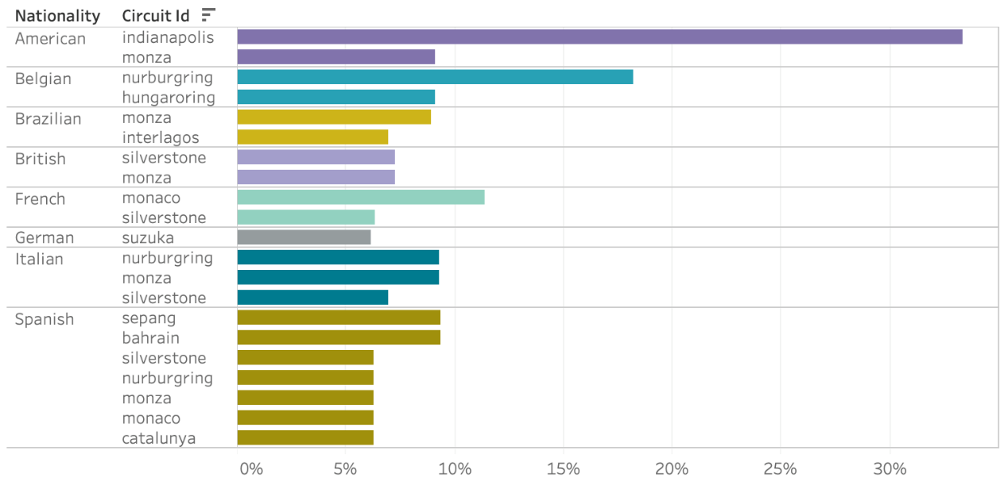
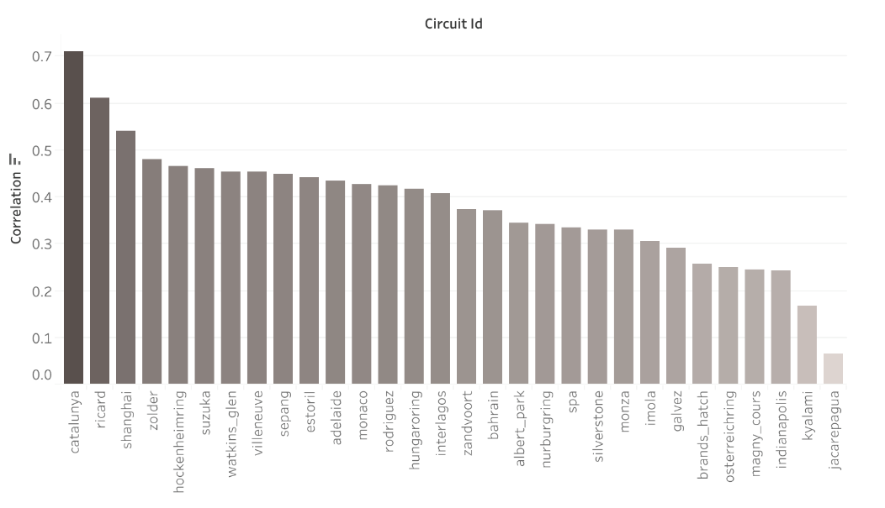
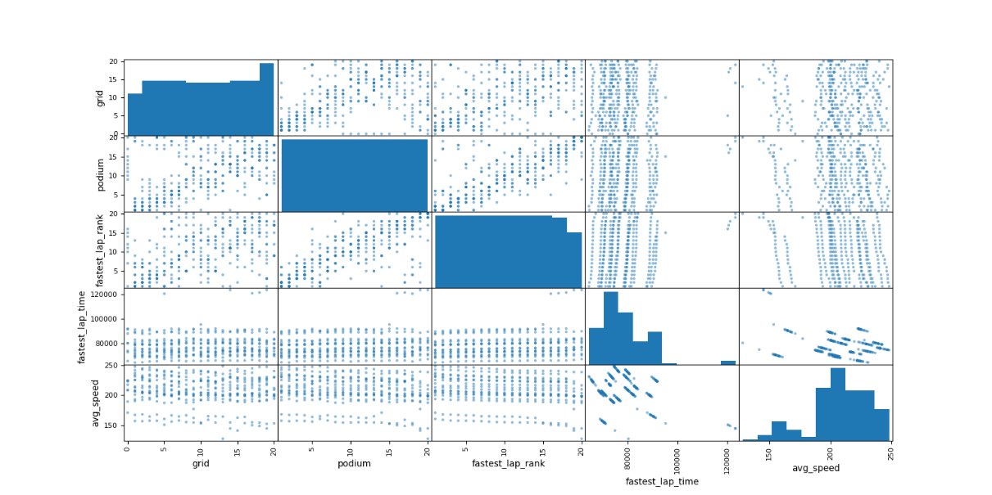
Project Methodology Continuation
Countries that have hosted the most races
Winning races in your home country
Importance of pole position
Multi-matrices to show trends between several features

Slide 8
Project Development
Tools Used
Machine Learning Models
Linear Regression: Linear regression analysis is used to predict the value of a variable based on the value of another variable. The variable you want to predict is called the dependent variable.
XGBoost Regressor: XGBoost stands for “Extreme Gradient Boosting”, where the term “Gradient Boosting” originates from the paper Greedy Function Approximation: A Gradient Boosting Machine, by Friedman. For more information navigate to https://xgboost.readthedocs.io/en/stable/tutorials/model.html
Issues During Development
Version conflicts: One issue that occurred frequently was the conflicts of Python versions. It is vital to use the correct Python version as stated in all the documentation of the project when executing the python scripts.
Data collection and processing: This was a very time consuming aspect of the application as not only gathering the necessary data to train thee machine learning models proved difficult but so was the processing and manipulation of the data was even more difficult to master.
User Interface: Not only was this the first time working with Linear regression and XGBoost within Python, but this was the first time I have used the tkinter library to create a user interface in Python. This was the biggest learning curve and I spent a lot of time reading through the documentation for the tkinter library.
VSCode
Git
Python
SQLite
Numpy
Pandas
sklearn
beautifulsoup4
customtkinter
Flask
matplotlib
Pillow
python_dateutil
requests
selenium
webdriver_manager

Slide 9
Project Testing
Testing Feedback
Thankfully my friends and family volunteered to test the application and they provided me with some helpful feedback:
Implement caching of both results and database queries to improve speeds on slower machines
Include Free Practice sessions results into the machine learning model
Make data collection run more frequently
Improve UI for prediction pages ie: Style the results better or display in a table format
Add another prediction option to display the results for all drivers / constructors not just one
Standardize UI styling ie: Round corner for buttons globally
Allow the user to adjust the screen size to their preference
Display drivers and constructors full names
Overall the user testing ran successfully and there were only some minor issues as discussed below.
Issues During Testing
Installation:
All of the issues faced during the testing phase of this project where with regards to the actual installation of the application.
The first issue was the wrong Python version, this application specifically needs a Python version 3.7 to execute.
The next issue was conflicting Python versions, if you have two different versions of Python installed it is important to have your environment variables correctly configured.
The last issue was incorrect Python Library versions, it is important to the correct versions of the required Python Libraries otherwise there might be some breaking changes in the newer versions.
All of these issues have been noted in the documentation and solutions as well as guidance is given in the documentation

Slide 10
Project Deliverables
Learning Outcomes
From this project, I will bring together the knowledge and skills developed throughout the degree programme in a bid to improve my weaknesses and also understand my strengths.
I also hope to develop technical expertise in computer science topics and gather experience in software development that will be essential to furthering my career.
In addition, this project should give me practical experience in applying methodologies, skills, and tools learnt as well as a better understanding of project management and the milestones associated with a software project.
Project Documentation
README.md: This file can be found in the root directory of this project and summarises aspects of the application.
Project-Presentation.pptx: This file can be found in the root directory of this project and presents the components and steps taken to create this project.
Project-Report.docx: This file can be found in the root directory of this project and is the full report of this project.
Improvments.txt: This file can be found in the root directory of this project and contains a list of improvements to be made for the project.
requirements.txt: This file can be found in the root directory of this project and contains the necessary libraries to run the application.
User Documentation: This file can be found in the .\Docs\build\html\index.html file and contains very detailed information and instructions about the application. This can also be viewed by executing the Open-F1-Predict-Documentation.bat file in the root directory of this project.
Repository Link: https://github.com/Quadrob/F1-Prediction

Slide 11
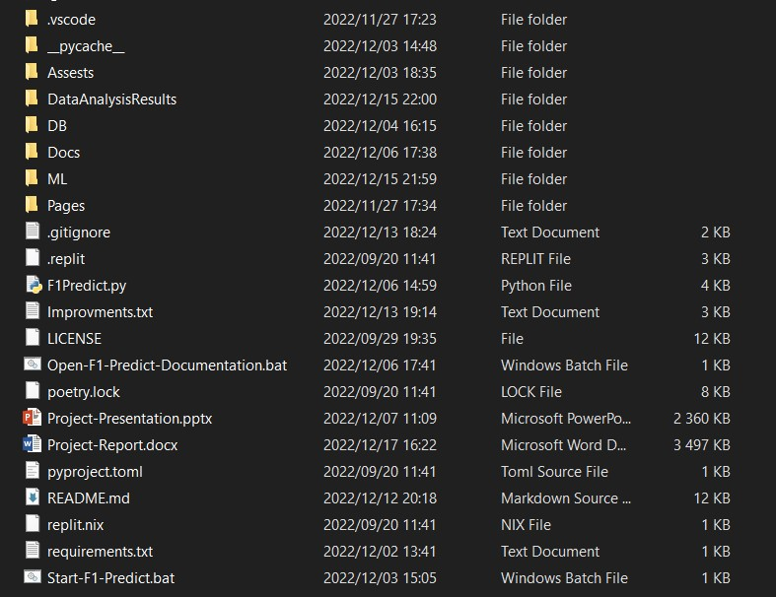
Project Presentation
Repository Explanation
Assets: Holds all the assets for the application such as images.
DataAnalysisResults: Holds all the data analysis python scripts and results.
DB: Holds the database and all the database related python scripts.
Docs: Holds all the projects user documentation.
ML: Holds all the python scripts related to the machine learning models.
Pages: Holds all the different python pages of the app
F1Predict.py: The main python script where the application starts up.
Improvements.txt: Future improvements for the app.
Open-F1-Predict-Documentation.bat: Open up user documentation with this file.
Project-Presentation.pptx: Project Presentation.
Project-Report.docx: Project Report.
requirements.txt: Required python libraries.
Start-F1-Predict.bat: Start up the application with this file.

Slide 12
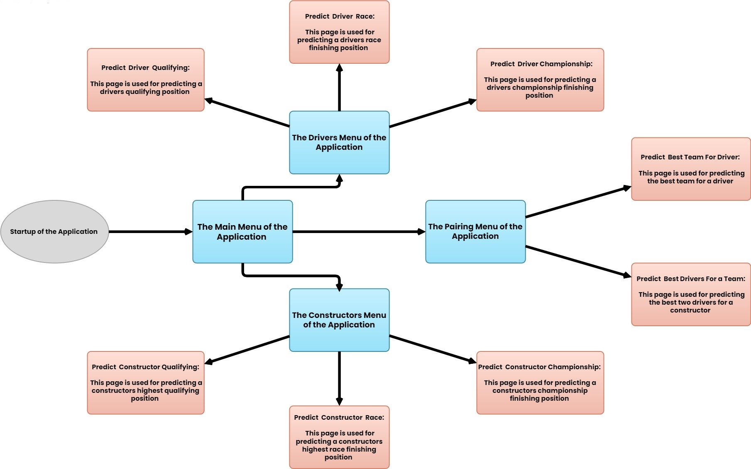
Project Presentation Continuation
Project Workflow
This workflow diagram presents the entire structure of the application and is effective for understanding what the application offers.
The grey object is the startup of the application
The blue rectangles represents each menu within the application
Each peach rectangle represents a single prediction page within the application as well as a brief description of what the propose of the page is.
Each arrow within the workflow diagram is bi directional

Slide 13

Project Presentation Continuation
Project Walkthrough
If the necessary libraries and components have been installed successfully then by running either the Open-F1-Predict-Documentation.bat or executing the F1predict.py file you should see this loading screen appear.
This might take a few minutes to load as it is performing a lot of tasks in the background such as:
Configuring the environment
Fetching all the necessary data from the database
Modifying and processing all that data into a single easily accessible table
Creating all the various pages of this application
At the bottom of the loading screen you will see the current version of the application as well as the last month / year the data collection function was executed.

Slide 14
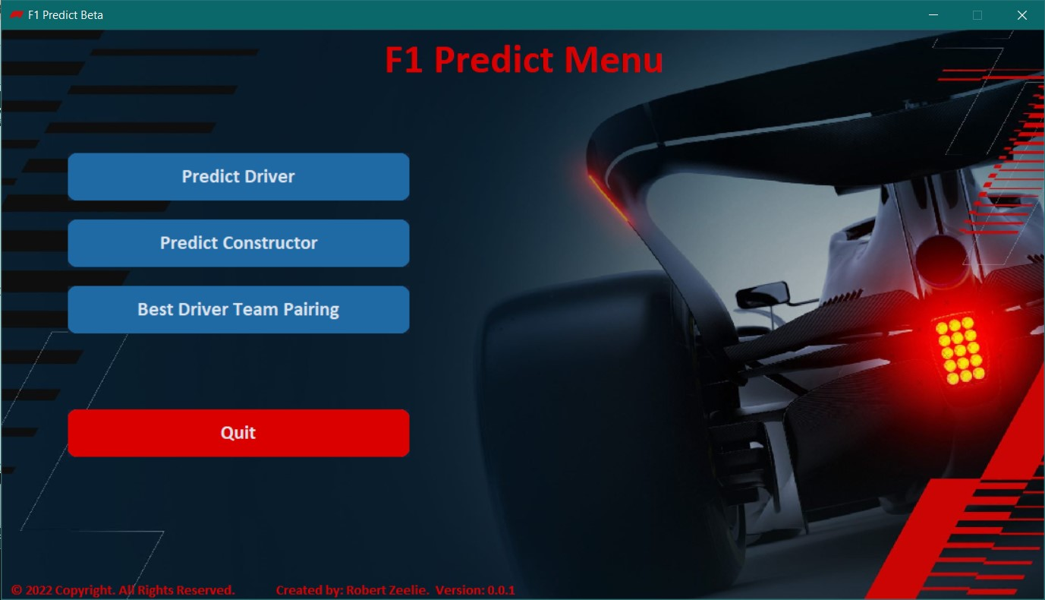
Project Presentation Continuation
Project Walkthrough
Once the loading screen has completed all the necessary tasks and configurations, the main menu of this application will be displayed.
The main menu is the root page of the entire application and the user can travel to any page from here.
The first button is to travel to the drivers menu where the user can predict a drivers qualification position, race finishing position, and a drivers championship finishing position. The drivers menu is almost identical to the main menu.
The second button is to travel to the constructors menu where the user can predict a constructors qualification position, race finishing position, and a constructors championship finishing position. The constructors menu is almost identical to the main menu.
The third button is to travel to the pairing menu where the user can predict the best team for a driver and the best two drivers for a team. The pairing menu is almost identical to the main menu.
The final button will exit the application.

Slide 15
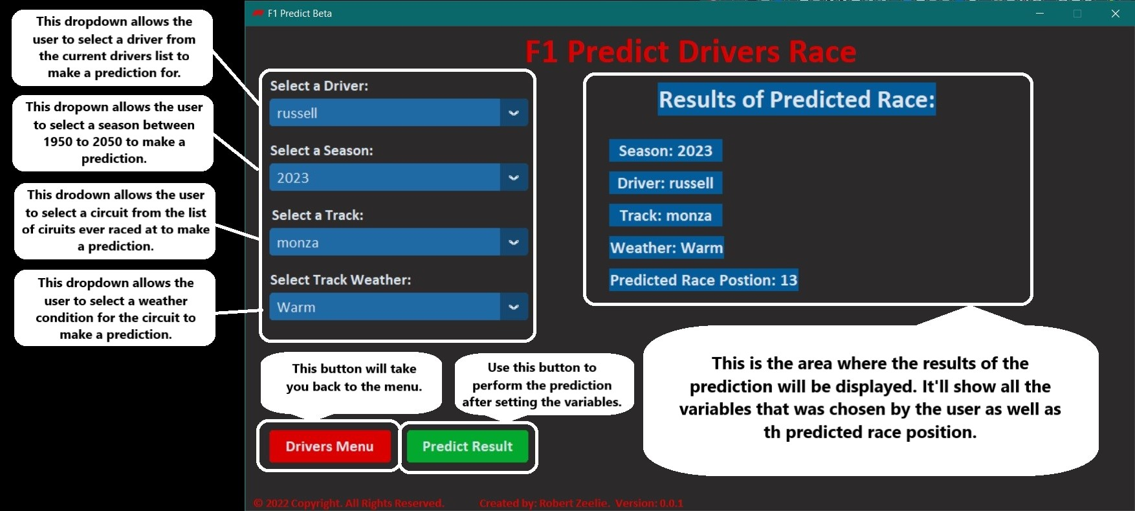
Project Presentation Continuation
Project Walkthrough
This slide will illustrate how to use as well as understand the output of the Predict Drivers Race page.
The top left section is where users can select the necessary variables for prediction on the page.
The red button on the bottom left of the page will navigate the user back to the previous menu.
The green button on the bottom left of the page will begin the prediction process with the variables selected in the first section.
The section to the right of the screen is where the results of the prediction will be displayed. If you don’t select all the necessary variables in the first section you will see an error message here.
The illustration on this slide explains each component in more detail.
As seen this page predicted that the driver Russell in season 2023 at monza in warm weather will finish 13th in the race.

Slide 16
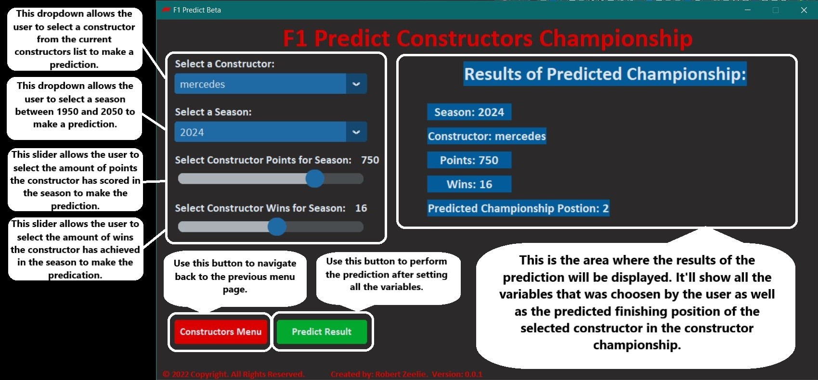
Project Presentation Continuation
Project Walkthrough
This slide will illustrate how to use as well as understand the output of the Predict Constructors Championship page.
The top left section is where users can select the necessary variables for prediction on the page.
The red button on the bottom left of the page will navigate the user back to the previous menu.
The green button on the bottom left of the page will begin the prediction process with the variables selected in the first section.
The section to the right of the screen is where the results of the prediction will be displayed. If you don’t select all the necessary variables in the first section you will see an error message here.
The illustration on this slide explains each component in more detail.
As seen this page predicted that the constructor Mercedes in season 2024 with 750 points and 16 wins will finish 2nd in the championship.

Slide 17
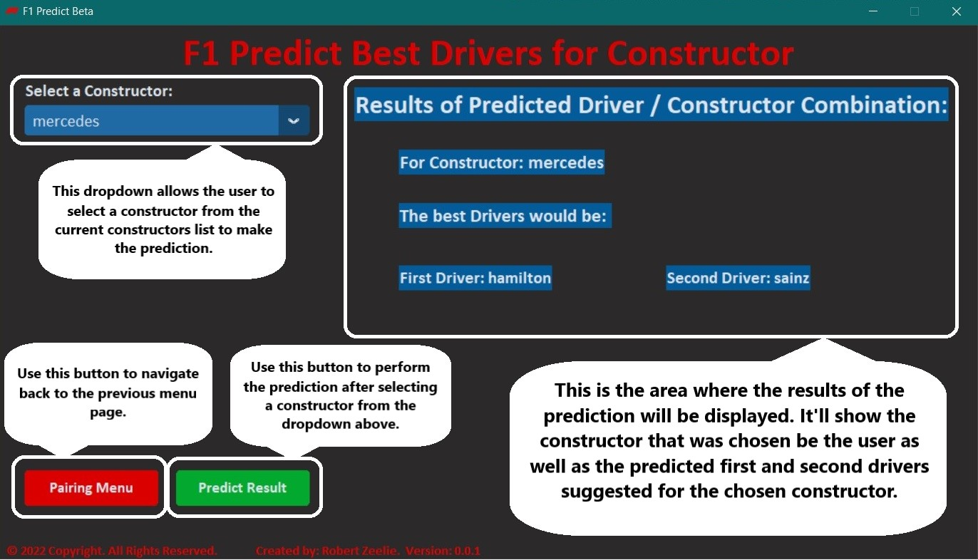
Project Presentation Continuation
Project Walkthrough
This slide will illustrate how to use as well as understand the output of the Predict Best Drivers for Constructor page.
The top left section is where users can select the constructor they want to predict for.
The red button on the bottom left of the page will navigate the user back to the previous menu.
The green button on the bottom left of the page will begin the prediction process with the variables selected in the first section.
The section to the right of the screen is where the results of the prediction will be displayed. If you don’t select all the necessary variables in the first section you will see an error message here.
The illustration on this slide explains each component in more detail.
As seen this page predicted that the two best drivers for Mercedes is:
First driver: Hamilton
Second driver: Sainz

Slide 18
Project Conclusion
With the focus on giving a Formal 1 team a competitive advantage, the approach to provide a scientific answer to the problem statement is supported by a thorough review of literature conducted within the field of machine learning and sports prediction.
After the development of the application and data analysis was completed, it was clear to see that the results of the project were a success, however, there was still room for improvement.
There were several times in this project when I struggled with topics that occurred due to a lack of knowledge or experience in a specific topic. Thankfully these hurdles were cleared by reading through various pieces of documentation, but these struggles were time costly and put pressure on my deadlines resulting in the lack of time to begin working on the list of improvements for the project.
The project can predict the results of qualifying, race, and championship for all current drivers and constructors with a 66% accuracy rate. In addition, the application can suggest the best pairing between drivers and constructors taking into consideration the impact of external factors.
The success of this project may spark further interest in the integration of machine learning into Formula 1 to improve the sport as well as gain competitive advantages over competitors.
I was able to successfully complete the project with the intended functionality within the specified time frame despite the setbacks and, more importantly, I was able to learn some vital problem-solving and project management skills. This project has made a tremendous impact towards my academic development and future career prospects as it provided me with a platform to bring together all the knowledge and skills I have gained thus far and put them to practice to better understand my abilities and grow as a developer.

Slide 19


Thank You
Link To GitHub Repository:
https://github.com/Quadrob/F1-Prediction
Robert Zeelie
robertbots@gmail.com

